Slide 1
MOVABLE DIVIDER
EXISTING SYSTEM-
In the existing system for the free flow of traffic heavy machines like barrier transfer machines are used for the movement of road dividers.Using this technique, a whole stretch of dividers are used to move either left or right based upon the traffic density.
DISADVANTSAGE:
Not efficient.
Time consuming.
It is not flexible.
Cannot detect automatically in case of traffic density.

Slide 2
Proposed System:
Traffic density measured by the microcontroller module.
When the signal turns red the traffic density measured and action takes place before it turns to green.
If the traffic density is high then the extended divider comes up and the normal divider goes to ground position.
Sensors will be deployed that will measure the conditions.
Sensors will measure the traffic density and the extended/normal dividers will move accordingly.

Slide 3
Features:
This proposed model can be operated automatically.
More organized traffic flow can be achieved, reducing traffic jams.
Based on the traffic density the time allotted for the passing of traffic is decided automatically.
Location based services can be done by means of enabled devices.
High traffic density can be detected through sensors and action could be taken accordingly.

Slide 4
Other technical solutions.
Lidar Gun- The most important solution is to follow the rules. The LIDAR (Light Detection and Ranging) gun is a tool that helps law enforcers to catch and book vehicles that cross the speed limit.
Speed Governors-Speed governors are essentially devices which put a cap on the speed that can be achieved that is below the vehicle’s natural maximum speed.
Variable message sign- Variable Message Signs are LED boards which can display important information that needs to be communicated to commuters.

Slide 5
Government initiated steps.
U-TURNS should be at short distance- Just to save time, people tend to take the wrong side of the road. U-turn should be provided at shorter distance.
Government should limit the number of vehicles owned by a single person.
Public Transport-Govt. should take appropriate steps for the betterment of public transports. It is quite unreliable and so people prefer going by their own vehicle.

Slide 6
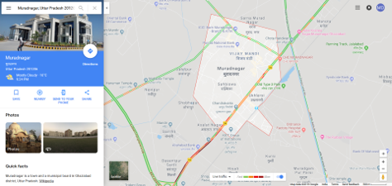
GOOGLE MAPS
Before leaving for destination one should check the real time traffic and then choose the road accordingly.

Slide 7
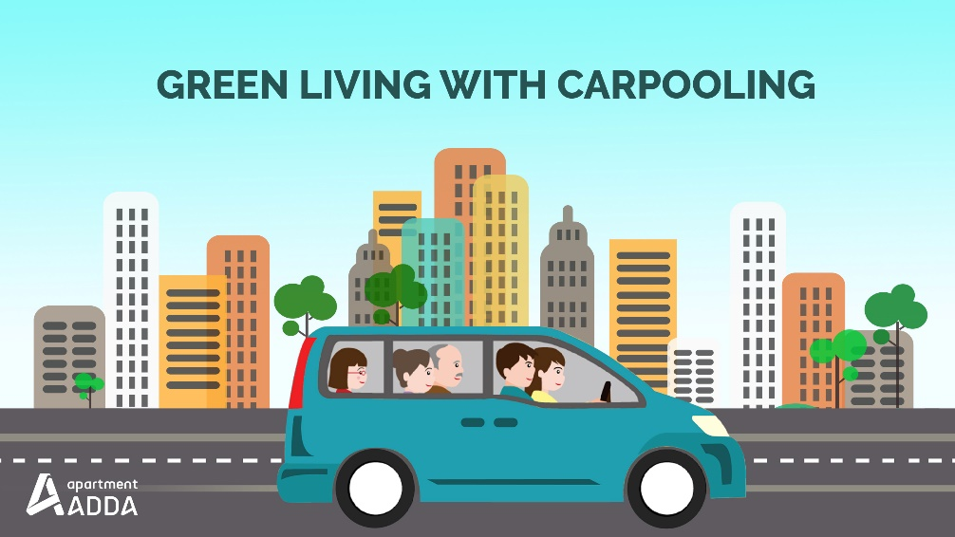
CARPOOLING
Carpooling is the sharing of car journeys so that more than one person travels in a car, and prevents the need for others to have to drive to a location themselves.

